Slide 1
IBM HACK CHALLENGE’20 TOPIC – IMPACT OF COVID-19 ON FOOD SECURITY – VISUALIZATION DASHBOARD TEAM NAME – NEOROTICS TEAM MEMBERS - PHALGUNI SHENDYE ANISH TALWELKAR ASHUTOSH PANDEY

Slide 2
OVERVIEW
PREOBLEM STATEMENT
Alarmed by a potential rise in food insecurity during the COVID-19 pandemic, many countries and organizations are mounting special efforts to keep agriculture safely running as an essential business, markets well supplied in affordable and nutritious food, and consumers still able to access and purchase food despite movement restrictions and income losses. We need to understand how the extended lockdowns / post lockdown situations can impact the food security of people in order to take effective decisions.
OUR APPROACH
Over the short-term, in addition to weaker demand, disruptions to supply chains could cause dislocations in commodity markets, with food security a key concern.
We have built two models - one that predicts the supply demand interralationship of various commodities based on a ratio called as Stocks to Use ratio and another model that predicts the prevalance of undernourishment and food insecurity based on the food security experince scale. We have visualized this data using various dashboards for better understanding.

Slide 3
TECHNOLOGY STACK
Python
R
Jupyter Notebook
RStudio
Tableau

Slide 4

RESEARCH
The coronavirus (COVID-19) pandemic has impacted both demand for and supply of commodities: direct effects from shutdowns and disruptions to supply chains, indirect effects as economic growth stalls. Effects have already been dramatic, particularly for commodities related to transportation.
Past episodes of major economic recessions or disruptions, as well as previous major disease outbreaks, can provide valuable insights into how Global Food Security may be affected. For example, the 2007­–2008 food price crisis was the worst shock to food markets since the early 1970s.
Agricultural prices are expected to remain broadly stable in 2020 as they are less sensitive to economic activity than industrial commodities, while production levels and stocks for most staple foods are at all-time highs. However, concerns about food security remain as countries announce trade restrictions and engage in excess buying.
Although, there are problems with food availability (and price spikes) at the local level due to supply chain disruptions and border closures in response to containment strategies, that are restricting food flows or movement of labor.

Slide 5
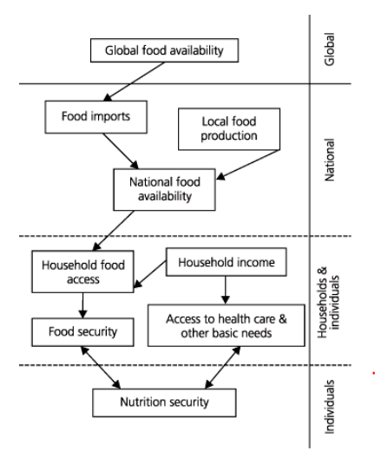
FOOD SECURITY
The United Nations define food security as "People having at all times, physical, social and economic access to sufficient, safe and nutritious food which meets their dietary needs and food preferences for an active and healthy life."
There are five methods that are commonly applied in national surveys that can be used to assess food insecurity. Of these, four are indirect or derivative measures of food insecurity (United Nations Food and Agriculture Organization method, household expenditure surveys, dietary intake assessment and anthropometry). The only method that represents a fundamental or direct measure of food insecurity is the one based on experience-based food insecurity scales.

Slide 6
ANALYZING THE SUPPLY-DEMAND INTERELATIONSHIP OF COMMODITIES
When it comes to analyzing and predicting the supply demand balance of commodities a ratio called the Stocks to Use Ratio plays a very important role.
Stock-to-use ratios show the balance between supply and demand for a given commodity
Higher stock-to-use ratios mean more supply is available while lower ratios suggest a tighter supply situation
Stock-to-use ratios have significant market impact and should be considered when creating marketing plans
The mathematical formula for this relationship is as follows
SToU = (Beginning Stock + Total Production – Total Use)/Total Use
Can be simplified as
SToU = (Carry Over)/(Total Use) * 100
The ratio can also be used to indicate how many days of supply is available to the world marketplace under current usage patterns.( eg. a 20% stocks to use ratio for wheat indicates that there are 75 days supply of wheat in reserve)

Slide 7
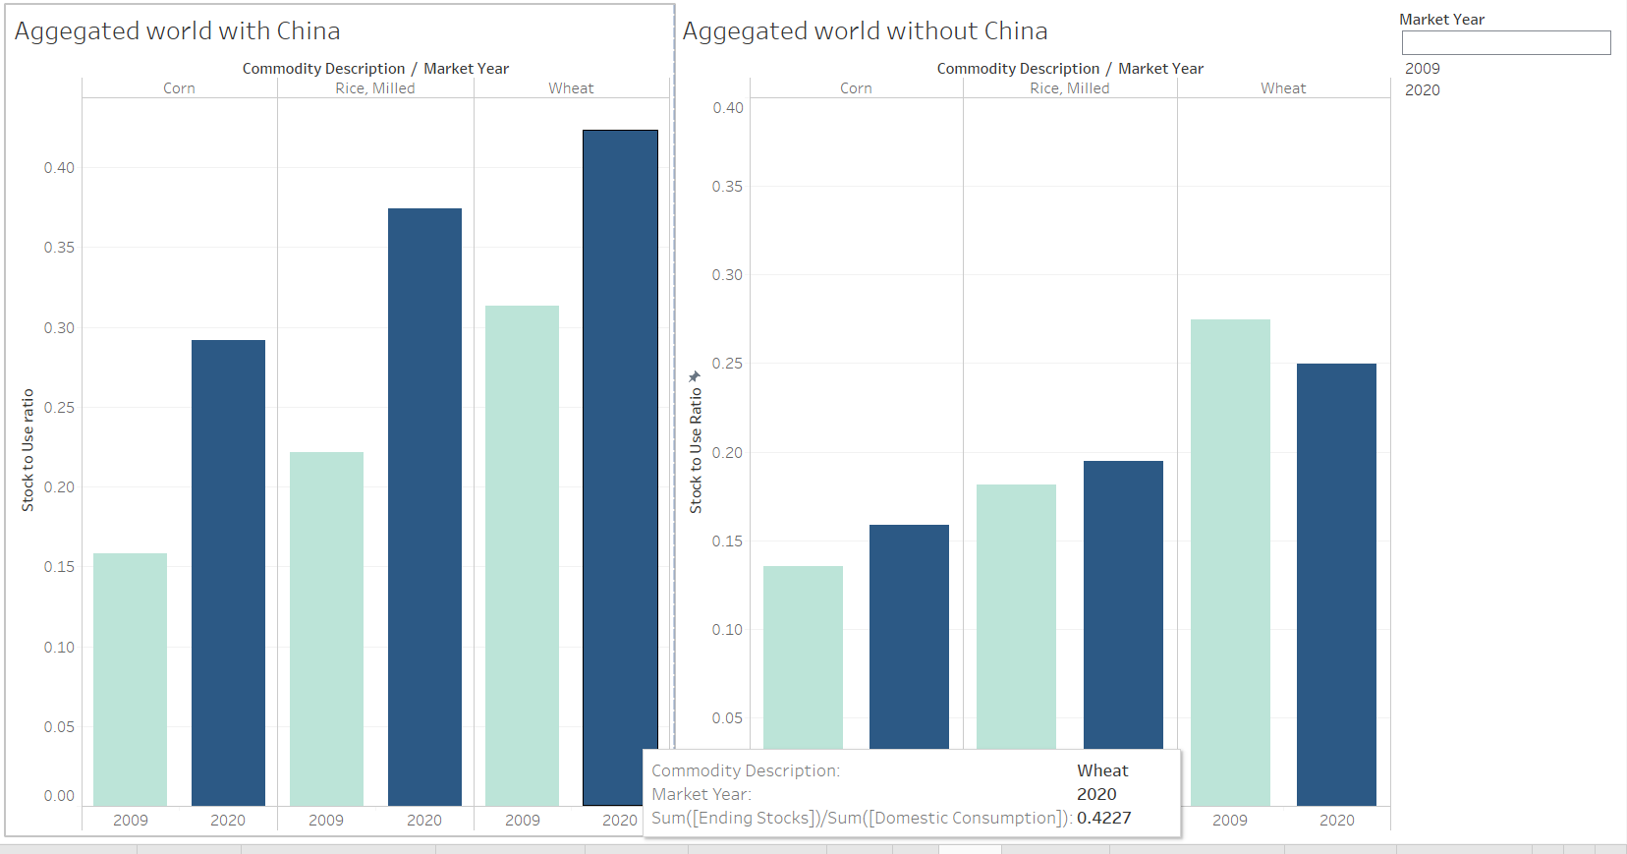
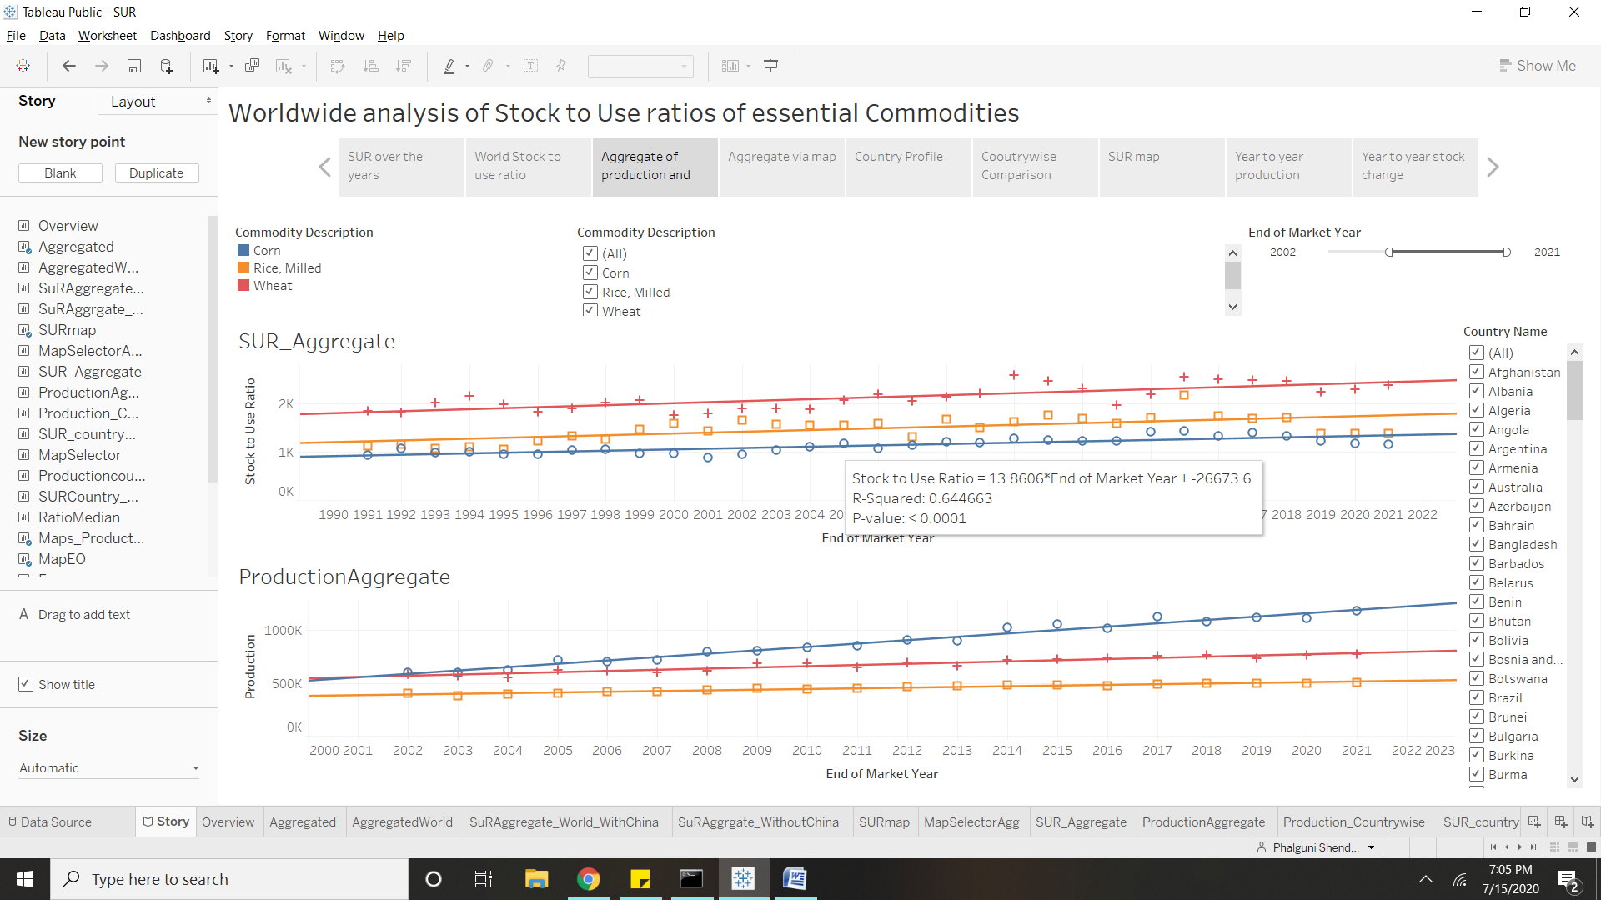
The dashboards help us understand the trend in worldwide production and stocks to use ratios of various commodities over the years -
THE STOCKS TO USE RATIOS WITH AND WITHOUT CHINA TO UNDERSTAND THE IMPACT OF CHINA ON GLOBAL AGRI TRADE
TREND IN PRODUCTION AND STOCKS TO USE RATIO OVER THE YEARS
LINK TO THE DASHBOARD
https://public.tableau.com/profile/phalguni.shendye#!/vizhome/SUR_15942289520880/Story

Slide 8
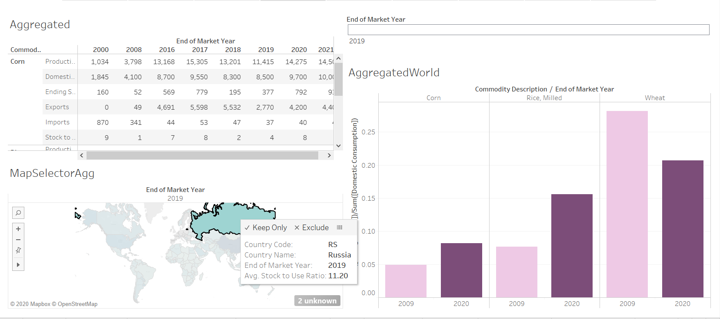
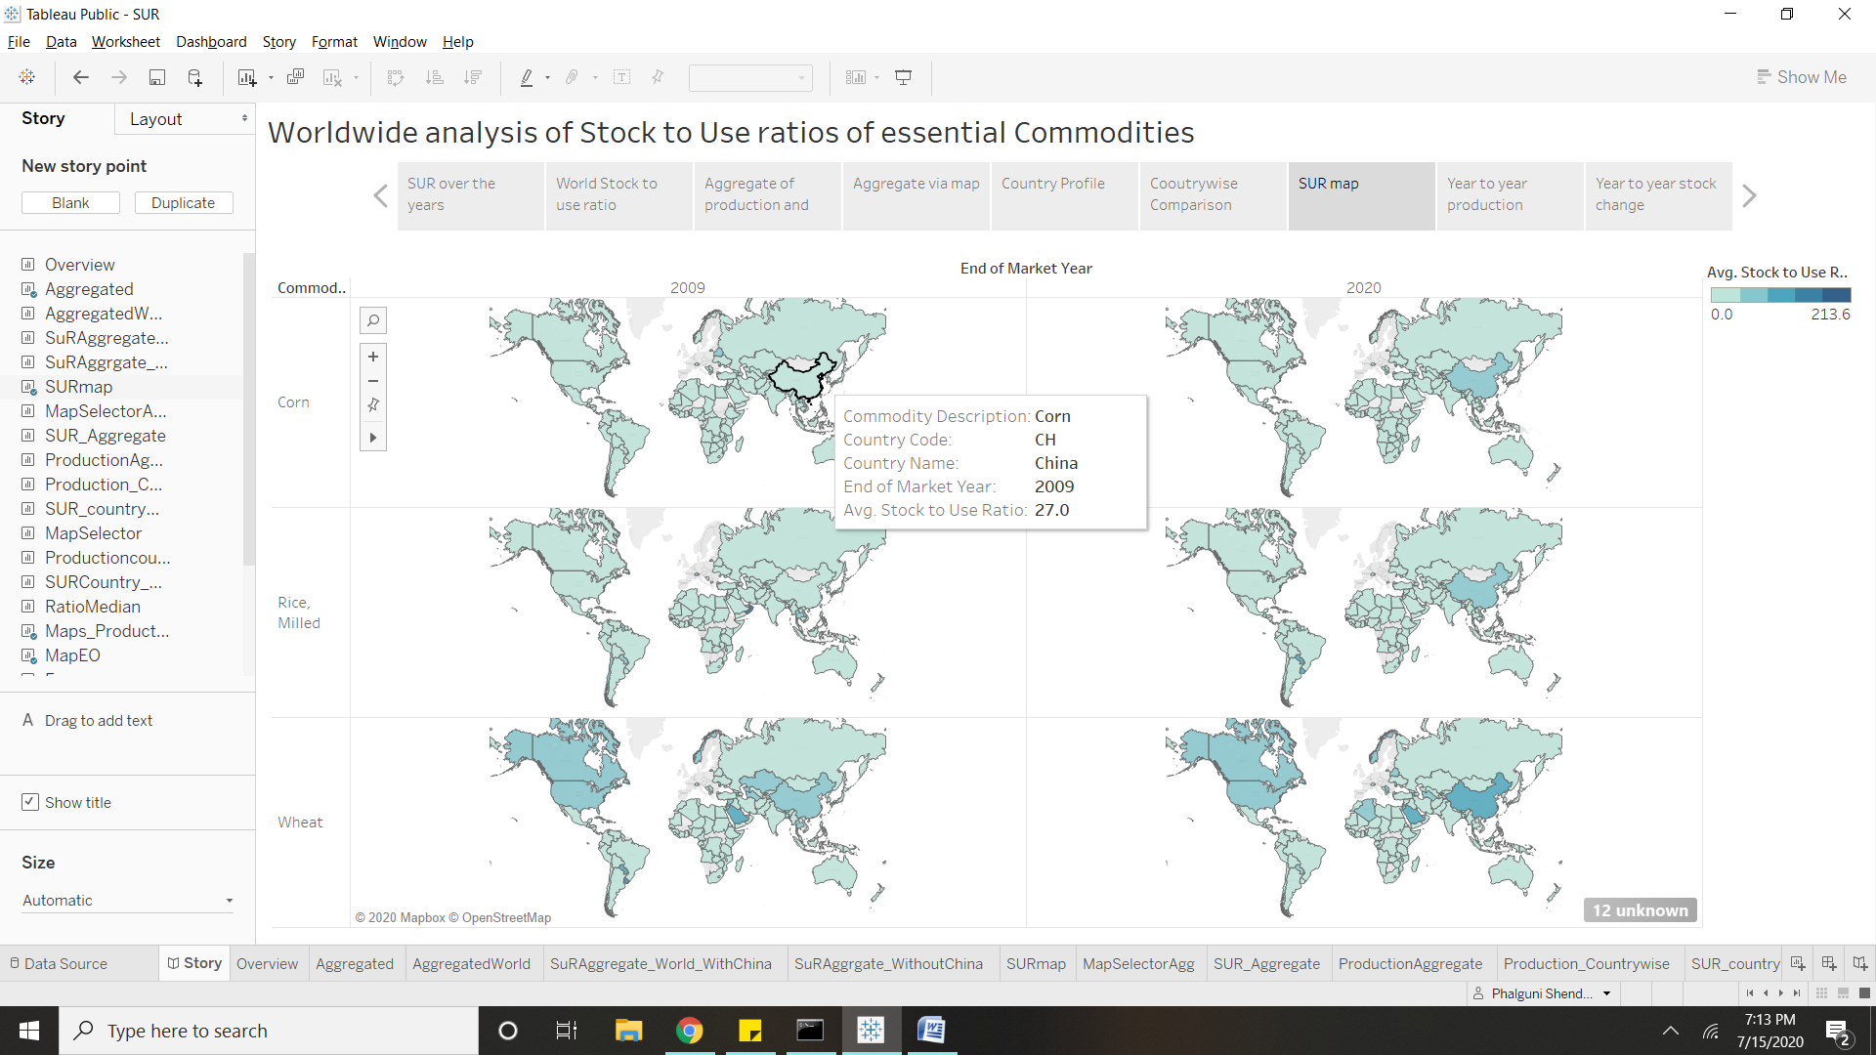
ANALYZE THE SUR OF A PARTICULAR COUNTRY USING MAPS
SURS OF ALL 3 COMMODITIES IN THE SPECIFIED YEARS. (WE’VE SHOWN 2009, TO COMPARE WITH THE FINANCIAL CRASH)

Slide 9
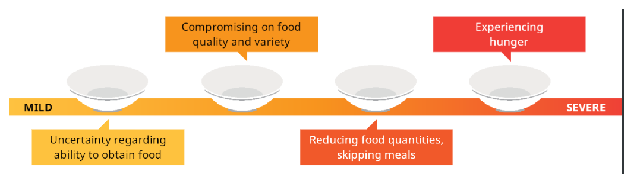
FIES ANALYSIS METHODOLOGY
The Food Insecurity Experience Scale or the FIES is a methodology to measure the severity of food insecurity as experienced by individuals or households in a way that is comparable across countries. The FIES is a new global standard for measuring food insecurity (access) that is valid, endorsed at the international level, and used for global and country monitoring
The FIES Survey Module (FIES-SM) consists of eight questions regarding people's access to adequate food, and can be easily integrated into various types of population surveys. The questions are :
During the last 12 months, was there a time when, because of lack of money or other resources:
1. You were worried you would not have enough food to eat?
2. You were unable to eat healthy and nutritious food?
3. You ate only a few kinds of foods?
4. You had to skip a meal?
5. You ate less than you thought you should?
6. Your household ran out of food?
7. You were hungry but did not eat?
8. You went without eating for a whole day?
The eight questions, when analyzed together, form a quantitative tool to measure the prevalence of food insecurity (at moderate and severe levels) in a given population using statistical methods.
.

Slide 10
STATISTICAL METHODS
ITEM RESPONSE THEORY AND THE RASCH MODEL
The approach used to analyze FIES data comes from Item Response Theory (IRT), a branch of statistics that permits the measurement of unobservable traits through analysis of responses to surveys and tests.
As food security itself is an inherently unobservable characteristic, such as attitude or intelligence, it can be measured only by examining its observable manifestations.
The specific IRT model applied to FIES data is the Rasch model, which is widely used in health, education and psychology.
The Rasch model provides a theoretical base and a set of statistical tools to 1) assess the suitability of a set of survey questions (“items”) for constructing a measurement scale and to
2) compare a scale’s performance across different populations and survey contexts.

Slide 11
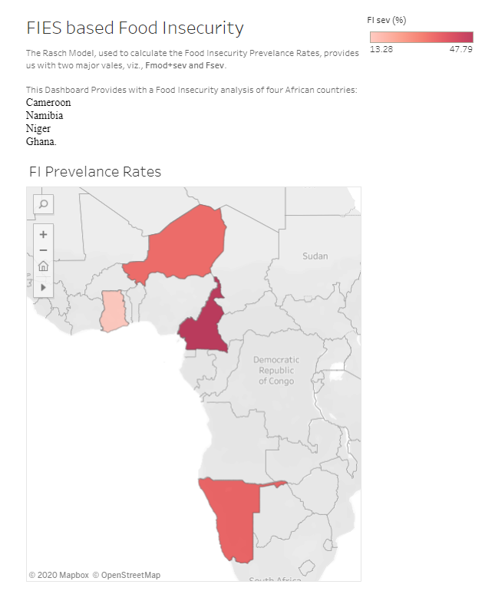
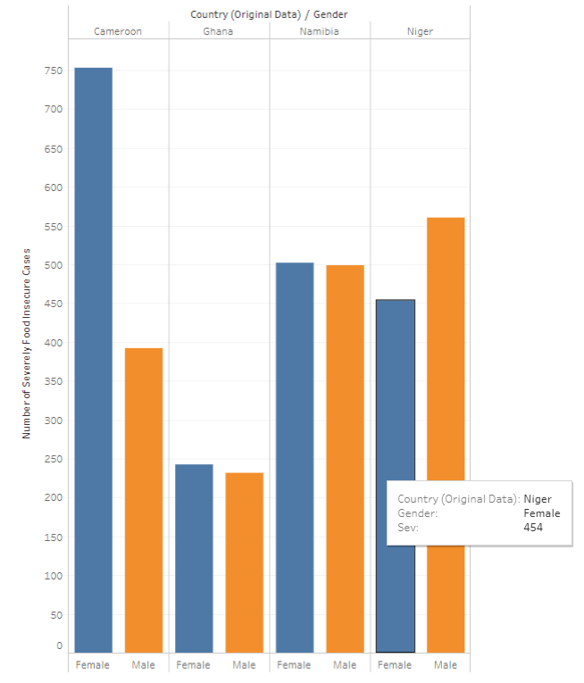
ANALYSIS USING DASHBOARDS
NUMBER OF FOOD INSECURE CASES BY GENDER
PREVALANCE OF UNDERNOURISHMENT
LINK TO THE DASHBOARD
https://public.tableau.com/profile/ashutosh.pandey3014#!/vizhome/RaschModel/FoodInsecurity?publish=yes

Slide 12
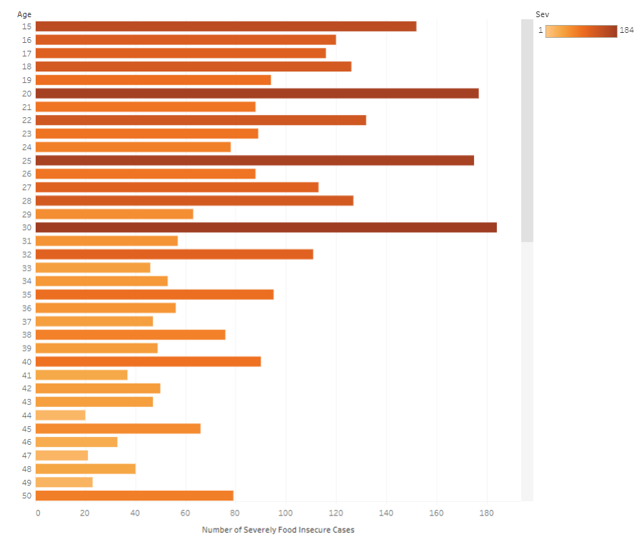
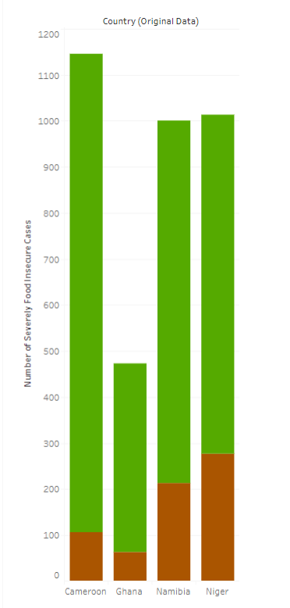
NUMBER OF FOOD INSECURE CASES IN RURAL AND URBAN AREAS
(Green – Rural, Brown - Urban)
NUMBER OF FOOD INSECURE CASES BY AGE

Slide 13
CONCLUSION
As the COVID-19 pandemic rages on, the entire world has been reeling under its effects.
We have visualized how disruptions in food supply chains can affect availability and access to food for millions of poor people around the world.
We have also tried to estimate the prevalence of food insecurity in various countries using the globally accepted Food Insecurity Experience Scale (FIES).

Slide 14
THANKS!
REFERENCES-
paper_COVID-19 and its Global Impact on Food and Agriculture
http://www.foodsecurityportal.org/api
https://apps.fas.usda.gov/psdonline/app/index.html#/app/home

